Slide 1
List group
Taught by Yossef Ayman Zedan

Slide 2
Overview
List groups are a flexible and powerful component for displaying a series of content. Modify and extend them to support just about any content within.

Slide 3
Basic example
The most basic list group is an unordered list with list items and the proper classes. Build upon it with the options that follow, or with your own CSS as needed.
<ul class="list-group">
<li class="list-group-item">An item</li>
<li class="list-group-item">A second item</li>
<li class="list-group-item">A third item</li>
<li class="list-group-item">A fourth item</li>
<li class="list-group-item">And a fifth one</li>
</ul>

Slide 4
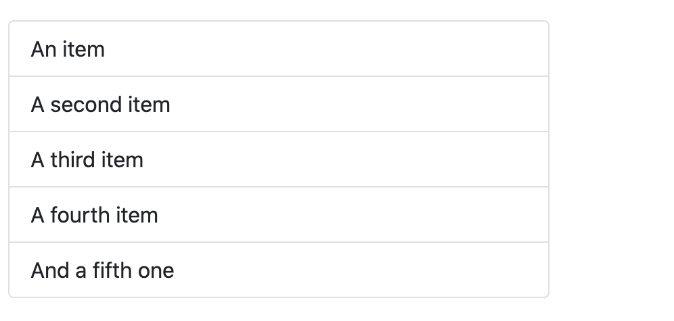
Basic example

Slide 5
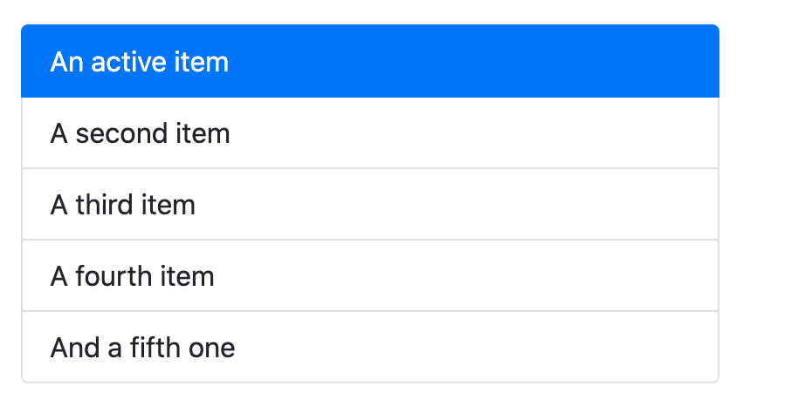
Active items
Add .active to a .list-group-item to indicate the current active selection.
<li class="list-group-item active">An active item</li>

Slide 6
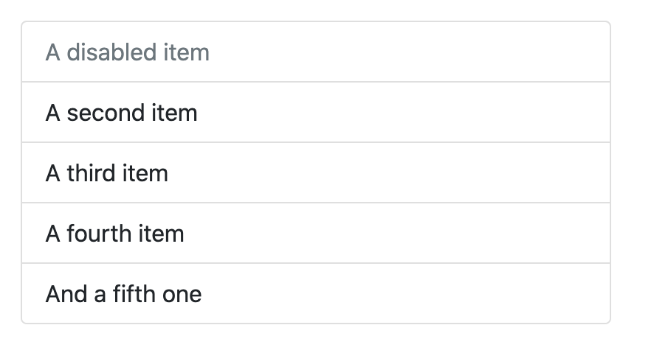
Disabled items
Add .disabled to a .list-group-item to make it appear disabled. Note that some elements with .disabled will also require custom JavaScript to fully disable their click events (e.g., links).
<li class="list-group-item disabled">A disabled item</li>

Slide 7
Links and buttons
Use <a>s or <button>s to create actionable list group items with hover, disabled, and active states by adding .list-group-item-action. We separate these pseudo-classes to ensure list groups made of non-interactive elements (like <li>s or <div>s) don’t provide a click or tap affordance.
Be sure to not use the standard .btn classes here.
<div class="list-group">
<a href="#" class="list-group-item list-group-item-action active" >
The current link item
</a>
<a href="#" class="list-group-item list-group-item-action">A second link item</a>
<a href="#" class="list-group-item list-group-item-action">A third link item</a>
<a href="#" class="list-group-item list-group-item-action">A fourth link item</a>
<a href="#" class="list-group-item list-group-item-action disabled">A disabled link item</a>
</div>

Slide 8
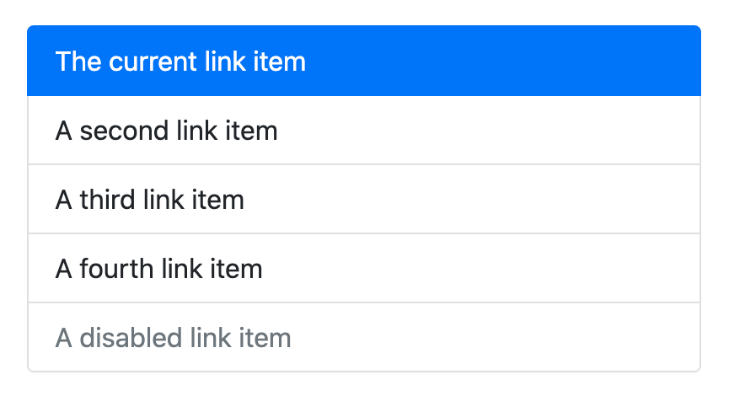
Links and buttons

Slide 9
Links and buttons
With <button>s, you can also make use of the disabled attribute instead of the .disabled class. Sadly, <a>s don’t support the disabled attribute.
<div class="list-group">
<button type="button" class="list-group-item list-group-item-action active">
The current button
</button>
<button type="button" class="list-group-item list-group-item-action">A second item</button>
<button type="button" class="list-group-item list-group-item-action">A third button item</button>
<button type="button" class="list-group-item list-group-item-action">A fourth button item</button>
<button type="button" class="list-group-item list-group-item-action" disabled>A disabled button item</button>
</div>

Slide 10
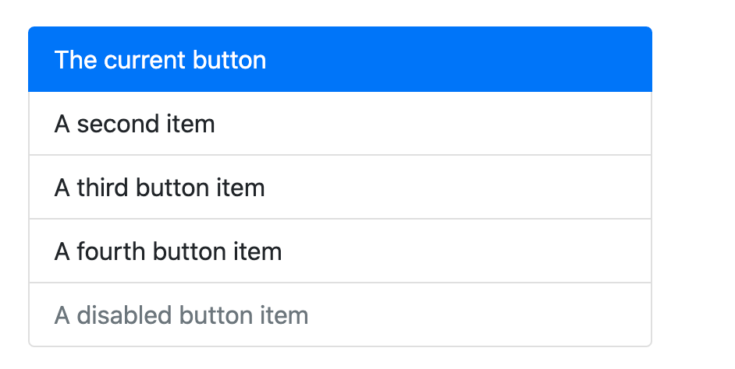
Links and buttons

Slide 11
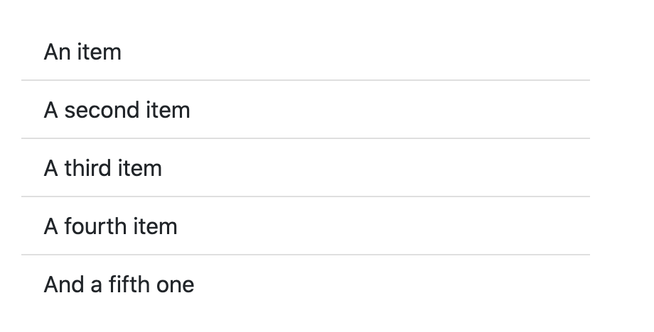
Flush
Add .list-group-flush to remove some borders and rounded corners to render list group items edge-to-edge in a parent container (e.g., cards).
<ul class="list-group list-group-flush">
</ul>

Slide 12
Numbered
Add the .list-group-numbered modifier class (and optionally use an <ol> element) to opt into numbered list group items. Numbers are generated via CSS (as opposed to a <ol>s default browser styling) for better placement inside list group items and to allow for better customization.
Numbers are generated by counter-reset on the <ol>, and then styled and placed with a ::before pseudo-element on the <li> with counter-increment and content.
<ol class="list-group list-group-numbered">
<li class="list-group-item">Cras justo odio</li>
<li class="list-group-item">Cras justo odio</li>
<li class="list-group-item">Cras justo odio</li>
</ol>

Slide 13
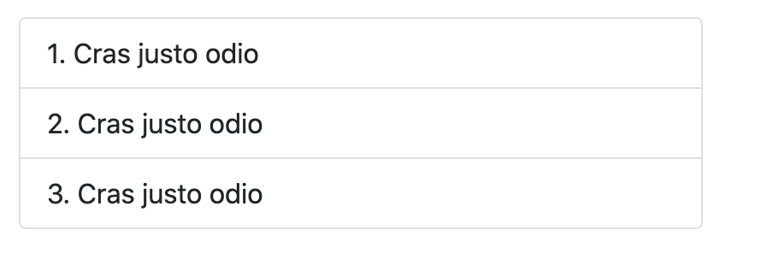
Numbered

Slide 14
Numbered
These work great with custom content as well.
<ol class="list-group list-group-numbered">
<li class="list-group-item d-flex justify-content-between align-items-start">
<div class="ms-2 me-auto">
<div class="fw-bold">Subheading</div>
Cras justo odio
</div>
<span class="badge bg-primary rounded-pill">14</span>
</li>

Slide 15
Numbered
<li class="list-group-item d-flex justify-content-between align-items-start">
<div class="ms-2 me-auto">
<div class="fw-bold">Subheading</div>
Cras justo odio
</div>
<span class="badge bg-primary rounded-pill">14</span>
</li>
<li class="list-group-item d-flex justify-content-between align-items-start">
<div class="ms-2 me-auto">
<div class="fw-bold">Subheading</div>
Cras justo odio
</div>
<span class="badge bg-primary rounded-pill">14</span>
</li>
</ol>

Slide 16
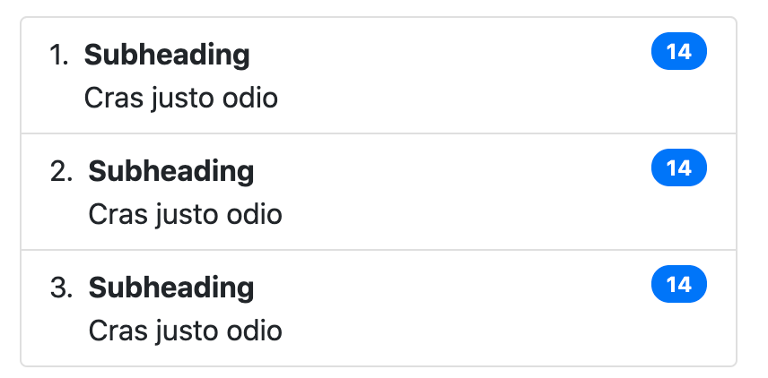
Numbered

Slide 17
Horizontal
Add .list-group-horizontal to change the layout of list group items from vertical to horizontal across all breakpoints. Alternatively, choose a responsive variant .list-group-horizontal-{sm|md|lg|xl|xxl} to make a list group horizontal starting at that breakpoint’s min-width. Currently horizontal list groups cannot be combined with flush list groups.
ProTip: Want equal-width list group items when horizontal? Add .flex-fill to each list group item.
<ul class="list-group list-group-horizontal">
<li class="list-group-item">An item</li>
<li class="list-group-item">A second item</li>
<li class="list-group-item">A third item</li>
</ul>
<ul class="list-group list-group-horizontal-sm">
<li class="list-group-item">An item</li>
<li class="list-group-item">A second item</li>
<li class="list-group-item">A third item</li>
</ul>

Slide 18
Horizontal
<ul class="list-group list-group-horizontal-md">
<li class="list-group-item">An item</li>
<li class="list-group-item">A second item</li>
<li class="list-group-item">A third item</li>
</ul>
<ul class="list-group list-group-horizontal-lg">
<li class="list-group-item">An item</li>
<li class="list-group-item">A second item</li>
<li class="list-group-item">A third item</li>
</ul>

Slide 19
Horizontal
<ul class="list-group list-group-horizontal-xl">
<li class="list-group-item">An item</li>
<li class="list-group-item">A second item</li>
<li class="list-group-item">A third item</li>
</ul>
<ul class="list-group list-group-horizontal-xxl">
<li class="list-group-item">An item</li>
<li class="list-group-item">A second item</li>
<li class="list-group-item">A third item</li>
</ul>

Slide 20
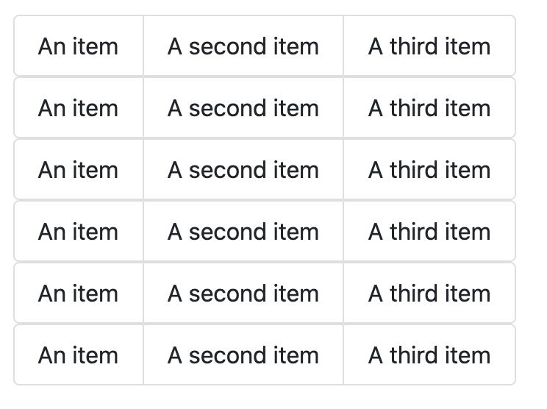
Horizontal

Slide 21
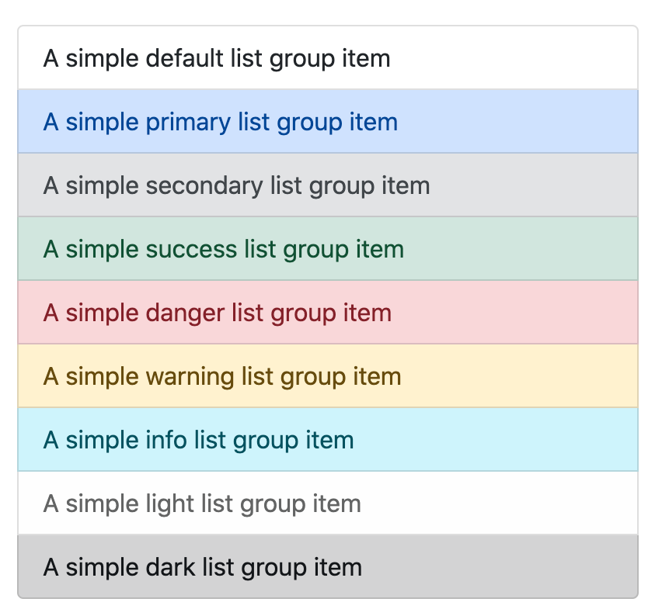
Contextual classes
Use contextual classes to style list items with a stateful background and color.
<ul class="list-group"> <li class="list-group-item list-group-item-primary">A simple primary list group item</li> </ul>

Slide 22
Contextual classes
Contextual classes also work with .list-group-item-action. Note the addition of the hover styles here not present in the previous example. Also supported is the .active state; apply it to indicate an active selection on a contextual list group item.
<div class="list-group"> <a href="#" class="list-group-item list-group-item-action list-group-item-primary">A simple primary list group item</a> </div>

Slide 23
With badges
Add badges to any list group item to show unread counts, activity, and more with the help of some utilities.
<ul class="list-group">
<li class="list-group-item d-flex justify-content-between align-items-center">
A list item
<span class="badge bg-primary rounded-pill">14</span>
</li>
<li class="list-group-item d-flex justify-content-between align-items-center">
A second list item
<span class="badge bg-primary rounded-pill">2</span>
</li>
<li class="list-group-item d-flex justify-content-between align-items-center">
A third list item
<span class="badge bg-primary rounded-pill">1</span>
</li>
</ul>

Slide 24
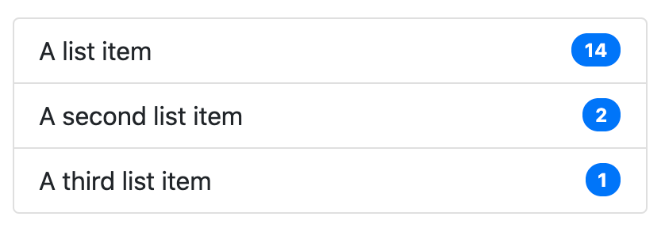
With badges

Slide 25
Custom content
Add nearly any HTML within, even for linked list groups like the one below, with the help of flexbox utilities.
<div class="list-group">
<a href="#" class="list-group-item list-group-item-action active">
<div class="d-flex w-100 justify-content-between">
<h5 class="mb-1">List group item heading</h5>
<small>3 days ago</small>
</div>
<p class="mb-1">Some placeholder content in a paragraph.</p>
<small>And some small print.</small>
</a>

Slide 26
Custom content
<a href="#" class="list-group-item list-group-item-action">
<div class="d-flex w-100 justify-content-between">
<h5 class="mb-1">List group item heading</h5>
<small class="text-muted">3 days ago</small>
</div>
<p class="mb-1">Some placeholder content in a paragraph.</p>
<small class="text-muted">And some muted small print.</small>
</a>
<a href="#" class="list-group-item list-group-item-action">
<div class="d-flex w-100 justify-content-between">
<h5 class="mb-1">List group item heading</h5>
<small class="text-muted">3 days ago</small>
</div>
<p class="mb-1">Some placeholder content in a paragraph.</p>
<small class="text-muted">And some muted small print.</small>
</a>
</div>

Slide 27
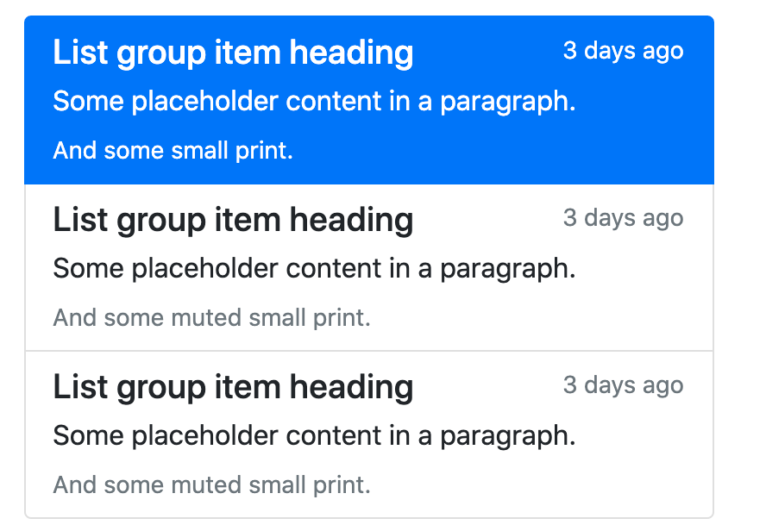
Custom content

Slide 28
Checkboxes and radios
Place Bootstrap’s checkboxes and radios within list group items and customize as needed. You can use them without <label>s.
<ul class="list-group">
<li class="list-group-item">
<input class="form-check-input me-1" type="checkbox" value="”>
First checkbox
</li>
<li class="list-group-item">
<input class="form-check-input me-1" type="checkbox" value=“”>
Second checkbox
</li>

Slide 29
Checkboxes and radios
<li class="list-group-item">
<input class="form-check-input me-1" type="checkbox" value="”>
Third checkbox
</li>
<li class="list-group-item">
<input class="form-check-input me-1" type="checkbox" value=“”>
Fourth checkbox
</li>
<li class="list-group-item">
<input class="form-check-input me-1" type="checkbox" value=””>
Fifth checkbox
</li>
</ul>

Slide 30
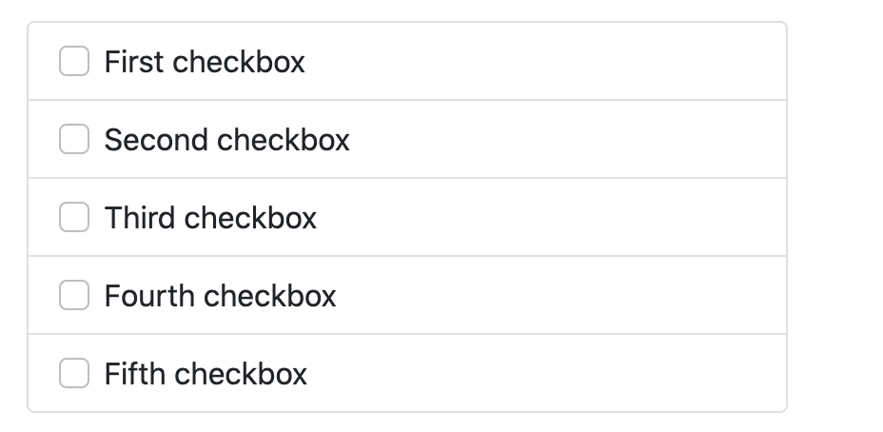
Checkboxes and radios

Slide 31
Checkboxes and radios
And if you want <label>s as the .list-group-item for large hit areas, you can do that, too.
<label class="list-group-item"> <input class="form-check-input me-1" type="checkbox" value=""> First checkbox </label>

Slide 32
JavaScript behavior
Use the tab JavaScript plugin—include it individually or through the compiled bootstrap.js file—to extend our list group to create tabbable panes of local content.
<div class="row">
<div class="col-4">
<div class="list-group" role="tablist">
<a class="list-group-item list-group-item-action active" id="list-home-list" data-bs-toggle="list" href="#list-home" role="tab">Home</a>
<a class="list-group-item list-group-item-action" id="list-profile-list" data-bs-toggle="list" href="#list-profile" role="tab">Profile</a>
<a class="list-group-item list-group-item-action" id="list-messages-list" data-bs-toggle="list" href="#list-messages" role="tab">Messages</a>
<a class="list-group-item list-group-item-action" id="list-settings-list" data-bs-toggle="list" href="#list-settings" role="tab">Settings</a>
</div>
</div>

Slide 33
JavaScript behavior
<div class="col-8">
<div class="tab-content”>
<div class="tab-pane fade show active" id="list-home" role="tabpanel">...</div>
<div class="tab-pane fade" id="list-profile" role="tabpanel">...</div>
<div class="tab-pane fade" id="list-messages" role="tabpanel">...</div>
<div class="tab-pane fade" id="list-settings" role="tabpanel">...</div>
</div>
</div>
</div>

